Slide 1
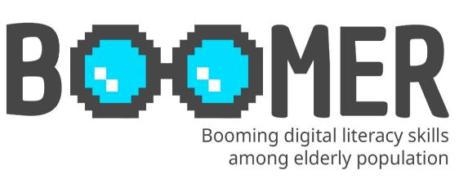
www.digital-boomer.eu
Navigating the World of Disinformation
Provided by: University of Dubrovnik

Slide 2
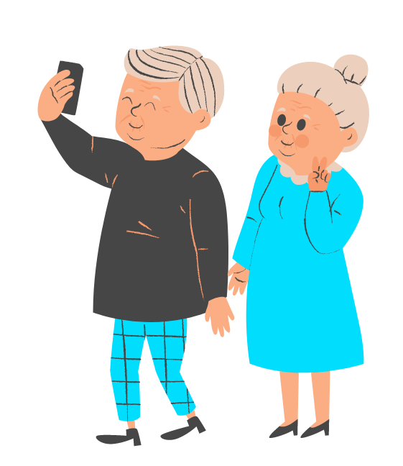
Index
Definition of disinformation and its impact on society
Common forms of disinformation
Understanding the motives behind disinformation The role of social media in the spread of disinformation
The role of fact-checking organizations
1
Understanding Disinformation
Recognizing disinformation and legitimate content
Red flags of disinformation
Fact-checking tools
2
Identifying Disinformation
Responsible online behavior
Recognize cognitive biases
Build resilience to disinformation
3
Responsible Online Behavior

Slide 3
Objectives
At the end of this module you will be able to:
understand disinformation, including its definition, common forms, and its impact on individuals and society.
develop and enhance your critical thinking skills that will enable you to evaluate information critically and apply these skills to identify and assess potential disinformation.
apply basic techniques of fact-checking to verify information before sharing it and
understand responsible online behavior.

Slide 4
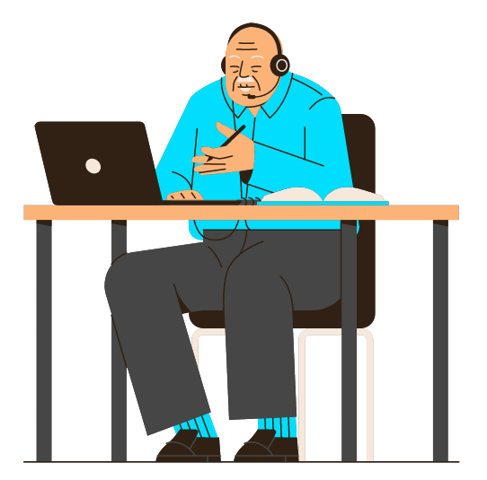
1.Understanding Disinformation

Slide 5
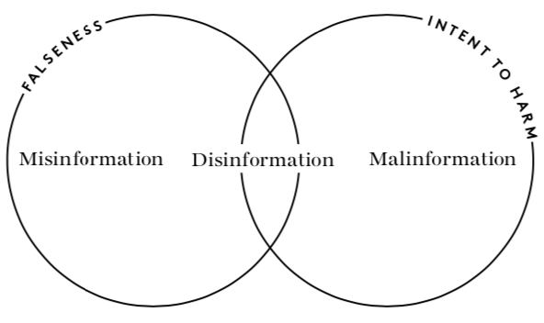
1.1. Definition of disinformation
Disinformation, misinformation and malinformation
Disinformation is false or misleading information that is intentionally spread with the purpose of deceiving or manipulating others.
Misinformation refers to false or inaccurate information that is spread without the deliberate intent to deceive. It can arise due to various reasons, such as misunderstanding, misinterpretation, or a lack of knowledge on the part of the person sharing the information.
Malinformation is true information that is shared with the explicit intent to cause harm, damage reputation, or invade privacy. It involves the deliberate disclosure of private or confidential information without consent, leaking sensitive documents, or sharing personal information to harm someone's reputation.
Source: https://firstdraftnews.org/long-form-article/understanding-information-disorder/

Slide 6
Type | Intent | Truthfulness of Information | Purpose
Disinformation | Intentional deception | False or misleading | Deceive, manipulate, shape public opinion
Misinformation | Unintentional dissemination | False or inaccurate | Lack of knowledge, misunderstanding
Malinformation | Deliberate harm | True | Cause harm, damage reputation, invade privacy

Slide 7
1.2. Types of disinformation
UNHCR (2022):
Fabricated Content: Completely false content;
Manipulated Content: Genuine information or imagery that has been distorted, e.g. a sensational headline or populist ‘click bait’;
Imposter Content: Impersonation of genuine sources, e.g. using the branding of an established agency;
Misleading Content: Misleading information, e.g. comment presented as fact;
False Context: Factually accurate content combined with false contextual information, e.g. when the headline of an article does not reflect the content;
Satire and Parody: Humorous but false stores passed off as true. There is no intention to harm but readers may be fooled;
False Connections: When headlines, visuals or captions do not support the content;
Sponsored Content: Advertising or PR disguised as editorial content;
Propaganda: Content used to manage attitudes, values and knowledge;
Error: A mistake made by established new agencies in their reporting.

Slide 8
1.2.1. Types of disinformation
Fabricated Content
The news of Pope Francis endorsing Donald Trump ahead of the 2016 US presidential election was fabricated—false information intentionally created and spread to deceive.
Source: https://firstdraftnews.org/long-form-article/understanding-information-disorder/

Slide 9
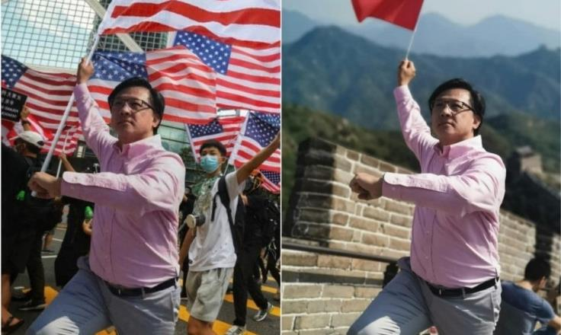
1.2.2. Types of disinformation
Manipulated Content
A doctored photo falsely depicts pro-Beijing politician Junius Ho waving the American flag at a pro-democracy march in Hong Kong, misleadingly shared on social media platforms.
.
Source: https://factcheck.afp.com/image-has-been-doctored-photo-hong-kong-politician-junius-ho-waving-chinese-flag-beijing

Slide 10
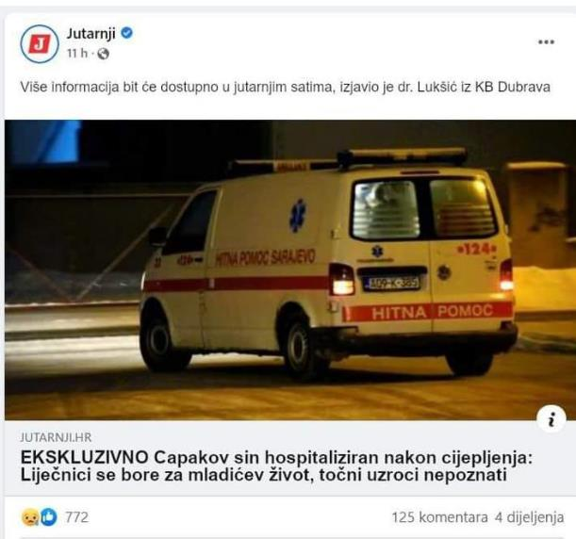
1.2.3. Types of disinformation
Imposter Content
The leading Croatian newspaper Jutarnji list allegedly published disinformation that the son of HZJZ director Krunoslav Capak was hospitalized after being vaccinated. The original headline was changed to create a misleading narrative and attributed to a reliable source.
Source: https://www.jutarnji.hr/vijesti/hrvatska/mrezama-se-siri-lazna-vijest-ne-capakov-sin-nije-zavrsio-u-bolnici-i-jutarnji-to-nikad-nije-objavio-15121369

Slide 11
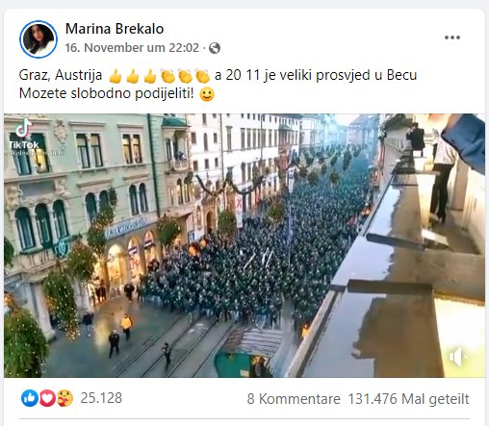
1.2.4. Types of disinformation
False Context
The photo shows 6,000 fans of Borussia Moenchengladbach playing against Wolfsberg at the Merkur Arena in Graz, Austria, and was featured on Facebook as an alleged protest against Covid 19 measures in Graz, Austria.
Source: https://www.24sata.hr/news/navijacku-povorku-iz-graza-je-objavila-kao-korona-prosvjed-milas-zasto-sto-imate-od-toga-797784

Slide 12
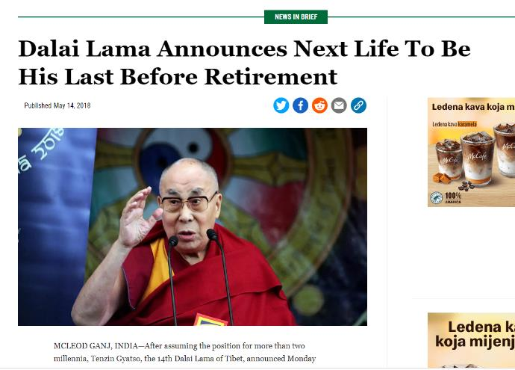
1.2.5. Types of disinformation
Satire and Parody
The satirical magazine The Onion published a joke that the Dalai Lama plans to retire after another lifetime. Many readers considered this to be correct information.
Source: https://www.theonion.com/dalai-lama-announces-next-life-to-be-his-last-before-re-1826007993

Slide 13
1.3.6. Types of disinformation
False Connections
The headline was overemphasized or misleading to entice a person to click on a link. Once the link is clicked, the user is redirected to another website that contains numerous advertisements and sometimes malicious content.
Source: https://ethicalmediatraining.eu/training/activities/media-disinformation/

Slide 14
1.3. Cheapfakes & deepfakes
Cheapfakes refer to manipulated or edited media that are relatively simple and low-cost to create. They typically involve basic modifications to images or videos, such as adding or removing elements, altering context, or applying basic filters.
Deepfakes refer to highly realistic and sophisticated manipulated media that are created using deep learning algorithms and artificial intelligence (AI) techniques.
Deepfake created with Ai

Slide 15
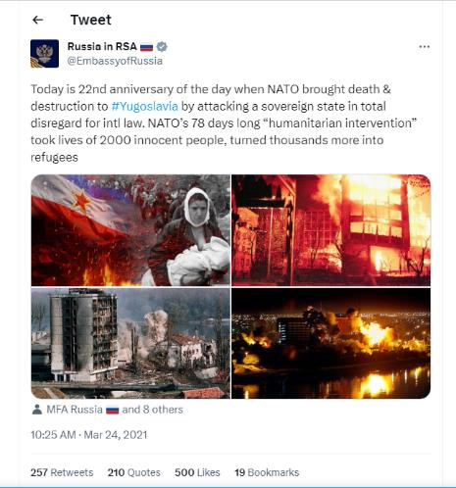
1.3.1. Example of cheapfakes
Source: https://en.ejo.ch/ethics-quality/the-cheapfake-photo-trend-fuelling-dangerous-propaganda
A 1999 Reuters photo showing an Albanian woman attempting to enter North Macedonia was later altered. The doctored image, which was disseminated as propaganda, falsely portrays the woman as a Serb victim of a bomb attack ( NATO ), as posted by the Russian Embassy on Twitter.

Slide 16
1.4. Conspiracy Theories
Conspiracy Theory | Description
9/11 Inside Job | Claims that the 9/11 attacks in the United States were orchestrated by the government to further political agendas or justify military actions.
Moon Landing Hoax | Suggests that the Apollo moon landings were faked by NASA as part of a larger conspiracy to deceive the public.
Illuminati Control | Alleges that a secret society called the Illuminati controls world events, governments, and major institutions to manipulate global affairs.
Chemtrails | Believes that airplane contrails are actually chemical or biological agents sprayed by the government for undisclosed purposes.
COVID-19 Bioweapon | Proposes that the COVID-19 pandemic was deliberately engineered or released as a bioweapon, rather than originating naturally.
Conspiracy theories are explanations or beliefs that propose a secretive, often nefarious, plot by a group of individuals or organizations to manipulate events or control certain outcomes. These theories typically involve allegations of hidden agendas, cover-ups, and collusion among powerful entities. Conspiracy theories often lack credible evidence and rely on speculation, misinterpretation, or fabrication of facts. They can cover a wide range of topics, from politics and government to health, science, and popular culture. Conspiracy theories can have significant social and psychological impacts, influencing public opinion, promoting distrust, and sometimes leading to harmful actions.

Slide 17
1.5. Fake news & pseudo media
Fake news refers to deliberately fabricated or misleading information presented as legitimate news. It can include false stories, manipulated images or videos, and misleading headlines that are spread through various channels, including social media, websites, and traditional media outlets. Fake news often aims to deceive or manipulate readers, provoke emotional responses, or advance specific agendas. It is important to critically evaluate sources and fact-check information to avoid falling for fake news and to promote the dissemination of accurate and reliable information.
Pseudo media are media outlets or platforms that engage in deceptive or misleading practices, presenting themselves as legitimate sources of news or information while lacking journalistic integrity or adhering to ethical standards. Pseudo media might intentionally disseminate false or biased information, manipulate facts, or engage in sensationalism to attract attention or promote certain narratives.

Slide 18
1.6. The motives behind disinformation
Political Manipulation: Disinformation can be used to manipulate public opinion, influence elections, or shape political narratives in favor of a particular candidate, party, or ideology. It aims to sow discord, undermine trust in democratic processes, or advance geopolitical interests.
Propaganda and Ideology: Disinformation can be employed to promote a specific ideology, advance propaganda agendas, or support extremist or separatist movements. It aims to shape perceptions, recruit supporters, or demonize opposing groups.
Economic Gain: Disinformation can be motivated by financial incentives. Individuals or groups may spread false information to drive traffic to their websites, increase ad revenue, or promote products or services based on deceptive claims.
Social Division and Polarization: Disinformation can exploit societal fault lines, exacerbate existing tensions, and deepen social divisions. By amplifying controversial or divisive issues, it aims to foster mistrust, create animosity, and undermine social cohesion.
Personal or Organizational Reputation: Disinformation can be used to tarnish the reputation of individuals, organizations, or institutions. It aims to damage credibility, undermine trust, or settle personal or professional rivalries.
State-Sponsored Influence: Disinformation campaigns can be orchestrated by nation-states to achieve strategic objectives. This may include spreading false narratives to destabilize rival nations, manipulate global perception, or advance foreign policy goals.

Slide 19
1.6.1. Veles story
Economic Gain
Teenagers in Veles, Macedonia used disinformation to create fake news websites, aiming to generate ad revenue. They produced sensationalized stories favoring Donald Trump, which gained significant social media traction. While the impact on the 2016 US elections is debated, it highlighted the vulnerability of online information ecosystems to manipulation.
Source: https://money.cnn.com/interactive/media/the-macedonia-story/

Slide 20
1.7. Impact on the society
Key ways in which disinformation can affect society:
Impact | Description
Undermining Trust | Erodes trust in institutions, media, and public figures, making it harder to discern between accurate and false information.
Polarization and Divisiveness | Exploits divisions, fosters animosity, and contributes to social polarization and unrest.
Manipulating Public Opinion | Shapes narratives, distorts public perceptions, and influences elections and policy decisions.
Public Health and Safety | Endangers public health by spreading false information about medical treatments, vaccines, and public health emergencies.
Economic Impact | Harms businesses and markets through false information affecting reputation, stock prices, and consumer behaviour.
Personal and Social Consequences | Damages individual reputations, spreads false accusations, and contributes to psychological distress and social cohesion erosion.
Misallocation of Resources | Wastes resources on debunking false claims, investigating fake news sources, and implementing measures to counter disinformation.
Threats to Democracy | Undermines democratic processes by manipulating information and potentially influencing election outcomes.

Slide 21
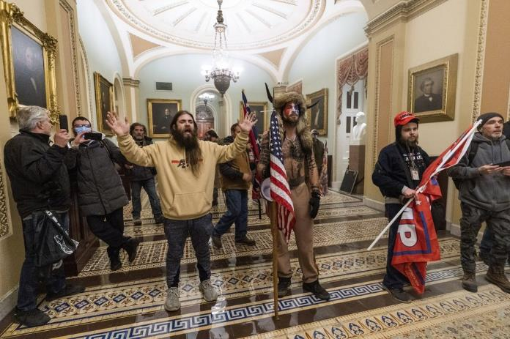
1.7.1. Example of Capitol Hill siege
Trump fans fueled US Capitol takeover
Disinformation played a significant role in the Capitol Hill siege on January 6, 2021. False election claims, conspiracy theories, and misattributions to Antifa and BLM fueled the belief that the election was stolen, radicalizing individuals. Extremist views were amplified, leading to the organization and coordination of the attack. Dissemination of false narratives downplayed the violent intent. The incident underscored the dangerous consequences of disinformation, highlighting its ability to incite real-world harm and undermine democratic processes.
Source: https://apnews.com/article/us-capitol-trump-supporters-1806ea8dc15a2c04f2a68acd6b55cace

Slide 22
Country | Facebook* | Instagram*
Austria | Over 660.000 | Over 46.000
Belgium | Over 990.000 | Over 66.000
Bulgaria | Over 510.000 | Over 18.000
Croatia | Over 410.000 | Over 21.000
Cyprus | Over 189.000 | Over 21.000
Czech Republic | Over 600.000 | Over 30.000
Denmark | Over 410.000 | Over 33.000
Estonia | Over 77.000 | Over 9.900
Finland | Over 180.000 | Over 30.000
France | Over 4.000.000 | Over 150.000
Germany | Over 3.700.000 | Over 210.000
Greece | Over 860.000 | Over 42.000
Hungary | Over 450.000 | Over 21.000
Ireland | Over 580.000 | Over 80.000
Italy | Over 4.000.000 | Over 170.000
Latvia | Over 180.000 | Over 10.000
Lithuania | Over 210.000 | Over 11.000
Luxembourg | Over 97.000 | Over 12.000
Malta | Over 81.000 | Over 9.200
Netherlands | Over 1.000.000 | Over 104.000
Poland | Over 1.700.000 | Over 52.000
Portugal | Over 1.600.000 | Over 240.000
Romania | Over 1.100.000 | Over 34.000
Slovakia | Over 360.000 | Over 17.000
Slovenia | Over 220.000 | Over 12.000
Spain | Over 3.500.000 | Over 200.000
Sweden | Over 620.000 | Over 69.000
Total EU | Over 28.000.000 | Over 1.700.000
1.8. The role of social media
From October 1 to December 31, 2022, the number of different posts on Facebook that received disinformation labels after being assessed for falsehood by fact-checking organizations.
Social media plays a significant role in the sharing of disinformation. Its ease of use and wide reach make it a breeding ground for the rapid spread of false or misleading information. Social media platforms amplify and disseminate misinformation through user-generated content, fake accounts, and algorithmic biases. The viral nature of sharing on social media can quickly amplify disinformation, leading to the erosion of trust, polarization of opinions, and potential real-world consequences.
Source: https://disinfocode.eu

Slide 23
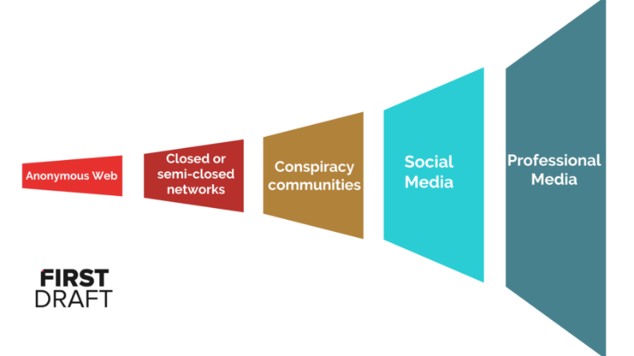
1.8.1. The trumpet of amplification
The diagram illustrates the path disinformation often takes, starting from anonymous web platforms, moving through closed groups, conspiracy communities, and eventually reaching open social networks and professional media. Disinformation agents aim to amplify their message, and unfortunately, they often succeed when false information is embedded in news articles.
Source: https://firstdraftnews.org/articles/5-lessons-for-reporting-in-an-age-of-disinformation/

Slide 24
1.9. The fact-checking organizations
Fact-checking organizations are independent entities dedicated to assessing the accuracy and veracity of claims made in public discourse, particularly in the media and online platforms. They employ journalists, researchers, and subject matter experts to investigate claims, analyze evidence, and provide objective evaluations. Fact-checkers utilize various methods, such as sourcing reliable information, conducting interviews, and analyzing data, to determine the validity of statements. Some well-known fact-checking organizations include PolitiFact, Snopes, FactCheck.org, AFP Fact Check, Full Fact, and The Washington Post's Fact Checker. These organizations play a crucial role in promoting truth and combating the spread of misinformation.
The list of fact-checking organisations https://en.wikipedia.org/wiki/List_of_fact-checking_websites

Slide 25
1.9.1. International Fact-Checking Network
The International Fact-Checking Network (IFCN) is a vital global organization that promotes accuracy and accountability in journalism. It sets standards for fact-checking organizations, offers training and resources, and facilitates the sharing of best practices. The IFCN also certifies fact-checkers through the transparent process of the IFCN Code of Principles. In parallel, the European Fact-Checking Standards Network Project, an EU initiative, brings independent fact-checking organizations together to define standards of independence, transparency, and journalistic quality in combating disinformation. These combined efforts enhance information quality and foster public trust in the media.

Slide 26
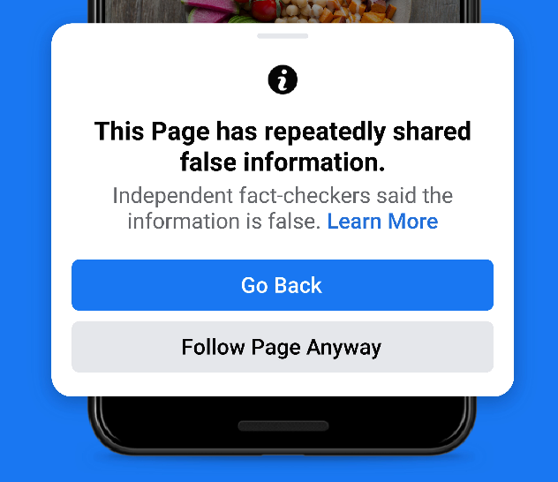
1.9.2. Meta (Facebook) and fact-checkers
Meta works with certified independent fact-checkers from the International Fact-Checking Network to combat disinformation. They work independently to review and evaluate potential disinformation on Meta's platforms. More than 90 organizations in 60 languages participate and take action against viral hoaxes and false claims. Meta and the fact checkers work together in three ways: Identifying potential disinformation, reviewing and evaluating the accuracy of content, and taking action. When content is determined to be false, its distribution is significantly restricted, warning labels are posted, and people are notified. Meta's three-part approach is to remove, reduce and inform about problematic content. Fact-checking partners adhere to IFCN's Code of Principles.

Slide 27
2.Identifying Disinformation

Slide 28
2.1. How to recognizing disinformation?
Recognizing disinformation can be challenging, as it often appears realistic and is disseminated widely. To analyze and identify disinformation, follow these steps:
Check the source for credibility and check the URLs.
Look beyond the headline and watch for grammatical errors and inconsistencies.
Distinguish between satire and factual content.
Check references in the story and their credibility.
Be aware of your personal bias and look at facts objectively.
Source: https://yali.state.gov/how-to-spot-disinformation/

Slide 29
2.1.1. Strange URLs
Strange URL | Example Website
abcnews.com.co | Fake news site posing as ABC News
cnn-trending.com | Fake news site imitating CNN
nytimes.com.co | Fake news site mimicking The New York Times
bbc-news.co.uk | Fake news site resembling BBC News
washingtonpost.com.co | Fake news site pretending to be The Washington Post
huffingtonpost.com.co | Fake news site masquerading as The Huffington Post
fox-news24.com | Fake news site imitating Fox News
nbcnews.com.co | Fake news site mimicking NBC News
usatoday.com.co | Fake news site posing as USA Today
time-news.net | Fake news site resembling Time Magazine

Slide 30
2.1.2. How do I know if a source is credible?
Look for content written by authoritative authors or reputable publishers, such as recognized experts in the field or well-established media outlets like the NY Times or Wall Street Journal.
Check for proper citations or references to reliable sources used in the content, ensuring transparency and the ability to verify the information provided.
Seek up-to-date information on your topic, as it reflects the most current understanding and knowledge surrounding the subject matter.
Ensure the content presents an unbiased analysis of the topic, where the author explores multiple perspectives and considers various viewpoints rather than favoring a particular stance.
Source: https://hbl.gcc.libguides.com/research/credible

Slide 31
2.2. Red flags of disinformation
Red Flags of Misinformation | Description
Lack of credible sources | Claims without credible sources should raise suspicion and indicate potential disinformation.
Emotional content | Disinformation often evokes strong emotions to manipulate readers. Be cautious when encountering emotionally charged posts.
Cross-posted content | Disinformers spread false information by sharing it across multiple social platforms. Watch out for content shared across platforms.
Disinformation in memes | Memes, while entertaining, can also be a source of disinformation. Be cautious and fact-check before sharing memes.

Slide 32
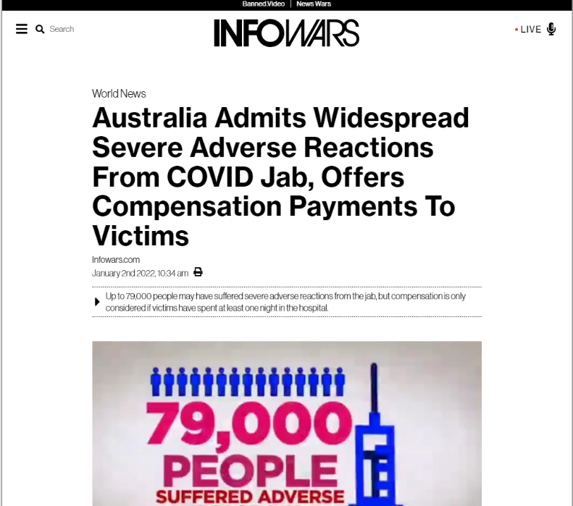
Check the domain name - Inforwars
Check the author –N/a
Check the date – January 2, 2022
Check the claims and access the sources the article reference
Read the article https://www.infowars.com/posts/australia-admits-widespread-severe-adverse-reactions-from-covid-jab-already-making-compensation-payments/
Watch the video mentioned in the article
https://www.youtube.com/watch?v=BzUSjTsjcac
Analysis:
Headline use „sever adverse” but referenced video use only „adverse”
Text:
„ 7News Australia reported on Friday that as much as 79,000 people have suffered from severe side effects from the COVID jab, and the government is prepared to dole out over $600,000 in compensation for some victims.”
Reference video report:
„ It’s estimated that 79,000 people have suffered adverse reactions to vaccines. Now the government’s offering compensation. Claims under $20,000 will need evidence from your doctor. Claims over $20,000 assessed by a team of legal experts. The highest figure reserved for only the most serious of cases”
„adverse" typically refers to something harmful, unfavorable, or detrimental, while "severe" indicates something intense, serious, or extreme.
Fact-check https://seecheck.org/index.php/2022/01/19/no-79000-severe-reactions-to-covid-19-vaccines-have-been-reported-in-australia/
False

Slide 33
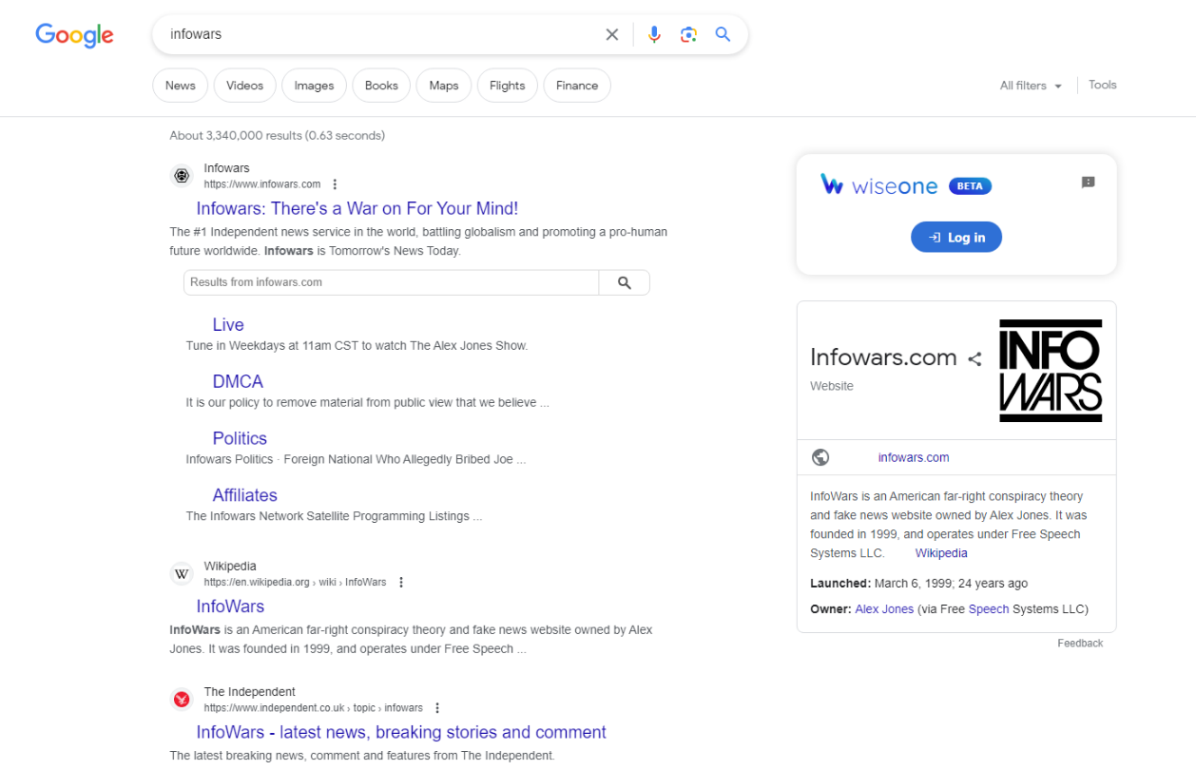

Slide 34
2.3. Fact-checking tools
Ordinary citizens have access to several fact-checking tools that can help them verify information and identify potential disinformation. One popular tool is "FactCheck.org," which provides unbiased analysis of political claims and news articles. "Snopes" is another well-known platform that verifies urban legends, rumors and misinformation. To verify content on social media, tools like "Google Reverse Image Search" can help determine the authenticity of images. In addition, browser extensions such as "NewsGuard" provide credibility ratings for websites that flag unreliable sources. Citizens can also consult reliable news outlets and use fact-checking databases such as "PolitiFact," "The Washington Post's "Fact Checker," or "AP Fact Check" to obtain accurate information. By using these tools, citizens can actively participate in the fight against disinformation and promote informed discussions.
The list of the tools: https://www.rand.org/research/projects/truth-decay/fighting-disinformation/search.html

Slide 35
3. Responsible Online Behavior

Slide 36
3.1. Recognize your cognitive biases
Cognitive biases are inherent tendencies in our thinking that can lead to errors in judgment. It is crucial for older adults to be aware of these biases when navigating the online world. Some common cognitive biases include confirmation bias (favoring information that confirms preexisting beliefs), availability bias (relying on readily available information), and anchoring bias (being influenced by initial information received). Recognizing these biases can help older individuals approach online content with a critical mindset and avoid being easily swayed by misleading information.
Recognize signs of cognitive bias
You pay attention only to news that confirms your opinion
You blame external factors when things do not go your way
Attributing other people's success to luck, while taking credit for your own achievements
Assuming that everyone else shares your opinions or beliefs
Learning a little about a subject and then assuming you know everything about it

Slide 37
3.2. Build resilience to disinformation
In order to navigate the online world responsibly, there are key steps to follow. First, verify information by fact-checking it before believing or sharing. Seek reliable sources and consult reputable fact-checking organizations, while cross-referencing information to ensure accuracy. Second, be mindful of emotional triggers that disinformation often exploits. Stay aware of content that evokes strong emotions and take a step back to evaluate credibility, considering alternative perspectives before reacting or sharing. Third, develop a critical eye when consuming online content by scrutinizing sources, checking for supporting evidence, and questioning claims that seem too good to be true or lack sufficient evidence. Lastly, seek out diverse perspectives to gain a well-rounded understanding, engaging with reputable news outlets, expert opinions, and alternative viewpoints to avoid falling into echo chambers and being swayed by one-sided narratives.

Slide 38
3.3. 6 steps to responsible online behaviour
Verify before sharing: Check the authenticity and credibility of information against reliable sources or fact-checking organizations before sharing.
Diversify your sources: Rely on multiple trusted sources for news and information to avoid bias and misinformation. Follow reputable news outlets, fact-checking websites, and experts in various fields.
Question and analyze: Develop a critical mindset by questioning the information you come across. Evaluate the source, examine the evidence presented, and assess possible biases or conflicts of interest.
Use fact-checking tools: Use fact-checking tools and resources available online to verify the accuracy of claims and statements.
Be aware of emotional triggers: Disinformation often aims to evoke strong emotions. Be aware of emotional triggers and take a moment to think before responding or sharing. Emotional reactions can cloud judgment and contribute to the spread of misinformation.
Report and flag disinformation: If you come across false or misleading information, report it to the platform or social media site where you found it.

Slide 39
Test your knowledge!
Please answer the following questions:
What is false or misleading information that is intentionally disseminated for the purpose of deceiving or manipulating others?
Disinformation Misinformation
Malinformation
What do we call manipulated or edited media that is relatively easy and inexpensive to create?
Deepfake
Cheapfake
Disfake
Why is it important to behave responsibly online?
To combat disinformation
To protect privacy
To make better decisions
In which phase of the "trumpet of amplification" do the disinformation agents reach their goal?
Anonymus web
Social media
Professional media
Who reviews the information for Meta?
Fact-checking organizations
Media organizations
Government agencies

Slide 40
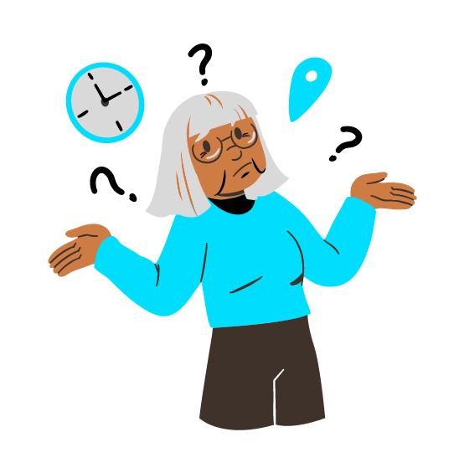
Summing up
Well done! Now you know more about:
Disinformation as deliberately false information aimed at deceiving or manipulating people, with far-reaching and detrimental effects on society.
The consequences of disinformation that can cause confusion, undermine confidence, and hinder informed decision making, especially for those in the 60+ age group.
The importance of fact-checking information, the role of emotional triggers, critically evaluating content, and seeking different perspectives to navigate the online world responsibly.

Slide 41
Bibliography
Cherry, K. (2022). What Is Cognitive Bias? https://www.verywellmind.com/what-is-a-cognitive-bias-2794963#:~:text=Signs%20of%20Cognitive%20Bias&text=Only%20paying%20attention%20to%20news,shares%20your%20opinions%20or%20beliefs
OpenAI. (2023). ChatGPT [GPT-3.5]. https://chat.openai.com/
Poynter.(2023). Misinformation red flags. https://www.poynter.org/mediawise/is-this-legit-digital-media-literacy-101/misinformation-red-flags/
UNHCR. (2022). Factsheet 4: Types of Misinformation and Disinformation. https://www.unhcr.org/innovation/wp-content/uploads/2022/02/Factsheet-4.pdf
Wardle, C. (2018). 5 Lessons for Reporting in an Age of Disinformation. https://firstdraftnews.org/articles/5-lessons-for-reporting-in-an-age-of-disinformation
Wardle, C. (2020). Understanding Information disorder. https://firstdraftnews.org/long-form-article/understanding-information-disorder

Slide 42
www.digital-boomer.eu
Thank you!

