Slide 1
www.digital-boomer.eu
Online Data Management
(Finding, storing and retrieving information)
Provided by: d-ialogo

Slide 2
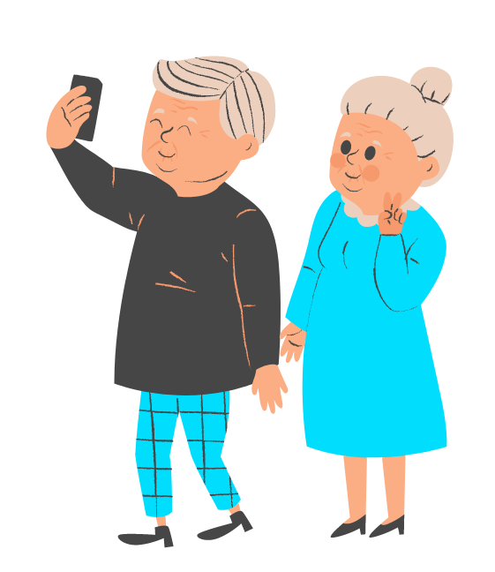
Index
1
Searching properly - or: How do I find the information that is important for me?
What are the benefits of the internet?
Barrier-free access as a necessity for the senior generation
The selection and use of search engines
2
Backing up files - or: How do I store my files systematically and in a structured way?
Importance of systematic file saving
Digital folder structure on the computer
Store files locally in the computer or in the cloud
3
Retrieving files - or: How do I keep track of the files I have saved?
Problems of a deficient filing structure
Tools for finding files in your own folder structure
Tips for Digital Online Management
2

Slide 3
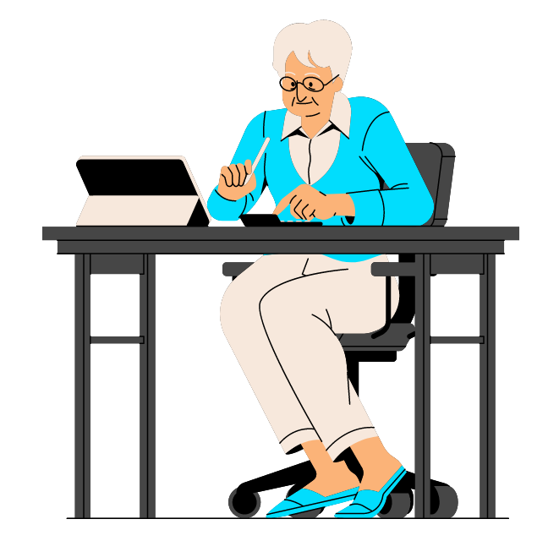
Objectives
At the end of this module you will be able to:
Knowing what information is important to me and how to find this data
Knowing exactly why systematically saving files is so important
Knowing what help is available to retrieve files
Knowing whether it makes more sense to store files on the computer or in the cloud
3

Slide 4
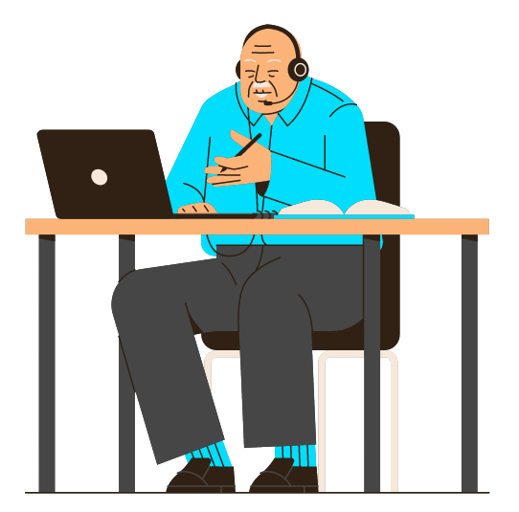
Unit 1
Search properly - or:
How do I find the information that is important for me?
4

Slide 5
1. What are the benefits of the internet?
Basis: people aged 14 and over (n = 2,035); figures in %.
Search for content and information in search engines
Use office programmes (e.g. word processing, spreadsheets, presentations).
Watching online videos (e.g. YouTube)
Use map services / navigation systems (e.g. Google Maps)
Use instant messaging services (e.g. WhatsApp, Threema, Telegram)
Online shopping, i.e. buying goods on the internet
Pay online (e.g. via Paypal, Paydirekt, Bitcoins)
Playing computer games or using game apps
Order or book services online (e.g. travel, food delivery service, car sharing, tradesmen).
Selling / offering goods or services via the internet (e.g. via eBay, quoka).
Use of so-called cloud services (e.g. Dropbox, Google Drive, Amazon Drive)
Use on-demand services or streaming (e.g. Spotify, Netflix, Amazon Prime).
Read blogs and forums or post content yourself
Use learning opportunities via the internet (e.g. online courses, online language learning).
Use voice control (e.g. Apple Siri, Google Assistant, Microsoft Cortana)
Collaboration with others via applications (e.g. Google Docs, Microsoft Sharepoint)
Use health / fitness applications (e.g. count steps, measure blood glucose levels).
Use smart home applications (e.g. "intelligent" heating control via app)
Regularly used services and applications
30-49 years: 41 %
Please indicate which of the activities you do on a regular basis, i.e. once or several times a week
30-49 years: 33 %.
30-49 years: 27 %
The 30-49 age group is particularly active in e-commerce (paying online, shopping online or ordering and offering services).
Source : Initiative D21 e.V. (2018), D21 DIGITAL INDEX 2017/2018. Jährliches Lagebild zur Digitalen Gesellschaft, in: initiatived21.de, 2018, https://initiatived21.de/app/uploads/2018/01/d21-digital-index_2017_2018.pdf
5

Slide 6
1. What are the benefits of the internet?
Benefits - subdivided according to age groups
TOP 3 - Applications according to age
75
38
40
50-64 years
Use of navigation services
Use of Office programs
Search by search engine
28
41
18
65+ years
Source : Initiative D21 e.V. (2018), D21 DIGITAL INDEX 2017/2018. Jährliches Lagebild zur Digitalen Gesellschaft, in: initiatived21.de, 2018, https://initiatived21.de/app/uploads/2018/01/d21-digital-index_2017_2018.pdf
6

Slide 7
1. What are the benefits of the internet?
Internet use - overview of the diverse applications (especially also for seniors)
Daily shopping
Shopping in the online shop for equipment, gifts
Travel bookings and mobility offers
Online banking - managing your own finances
Municipal services (e.g. tax return)
Communication with family, friends and at work
Information - Daily newspaper, news
Smart Home - using the internet to control the household
Health portals and communication with health insurance companies
Source : Treppenlift-ratgeber.de, Internet für Senioren: Werden Sie zum Silver Surfer, in: treppenlift-ratgeber.de, https://www.treppenlift-ratgeber.de/barrierefrei-leben/leben-im-alter/internet-fuer-senioren.html + diabsite.de, Welchen besonderen Nutzen bietet das Netz für Senioren?, in: diabsite.de, 24.06.2007, https://www.diabsite.de/wegweiser/links/internet/5-senioren.html
7

Slide 8
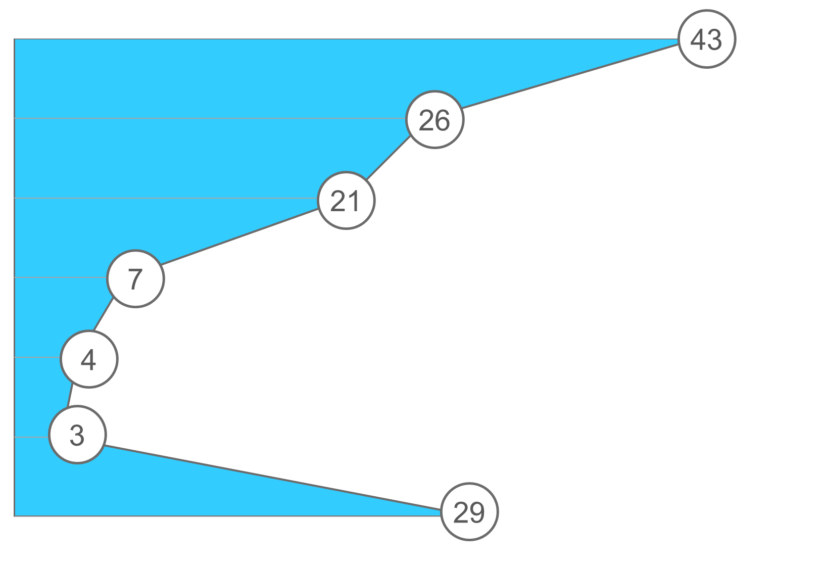
1. What are the benefits of the internet?
Booking services via the Internet
Age:
14 - 29
30 - 49
50+
Travel (e.g. for train journeys, bus journeys, flights or hotels)
Private accommodation (e.g. Airbnb)
Delivery services (e.g. for ordering food or meals)
Driving services (e.g. Uber or myTaxi)
Cleaning services and craftsman (e.g. helpling, My-Hammer)
Car sharing (e.g. car2go, DriveNow)
None of them
Basis: people aged 14 and over (n = 2,035); data and deviations in %.
46
64
31
28
37
19
45
31
7
13
12
2
1
6
3
6
5
1
34
26
29
Source : Initiative D21 e.V. (2018), D21 DIGITAL INDEX 2017/2018. Jährliches Lagebild zur Digitalen Gesellschaft, in: initiatived21.de, 2018, https://initiatived21.de/app/uploads/2018/01/d21-digital-index_2017_2018.pdf
8

Slide 9
2. Barrier-free access as a necessity for the senior generation
Access for all - mandatory for every provider of services on the internet
Accessibility applies not only analogue but also digital
More and more older people with disabilities are using the net - privately or professionally. Access should be possible for all
Conversion of online offers leads to age-appropriate design of pages and barrier-free use
Only use sites that meet exactly this requirement and offer this quality !
9

Slide 10
2. Barrier-free access as a necessity for the senior generation
How can accessibility on the internet help?
People with visual impairments, physical disabilities, deafness, hearing impairments and mental disabilities can be helped by an accessible website to understand its content.
Because the barriers on the net are manifold for people with disabilities:
Insufficient navigation aids
Poor colour contrast
Only operable with mouse, not with keyboard
No read aloud function for the text
Assistive technologies such as screen readers, screen magnifiers or mouth controlled mouce help in some cases, but the accessible design of websites is much better.
Source : Treppenlift-ratgeber.de, Internet für Senioren: Werden Sie zum Silver Surfer, in: treppenlift-ratgeber.de, https://www.treppenlift-ratgeber.de/barrierefrei-leben/leben-im-alter/internet-fuer-senioren.html
10

Slide 11
2. Barrier-free access as a necessity for the senior generation
Accessibility means
Correctly placed colour contrasts help with red-green visual impairment.
An offer of translation into "easy language" -is implemented mainly on public sites.
Content is presented visually for the deaf or hard of hearing.
The font size of the page is scalable.
Pages are navigable with the keyboard.
The page offers the possibility to have the content read aloud.
A ⇨ A
Source : Treppenlift-ratgeber.de, Internet für Senioren: Werden Sie zum Silver Surfer, in: treppenlift-ratgeber.de, https://www.treppenlift-ratgeber.de/barrierefrei-leben/leben-im-alter/internet-fuer-senioren.html
11

Slide 12
3. The selection and use of search engines
The "right" search engine
On the internet we find information on a wide variety of topics
Searching by search engine helps to search the Internet in a targeted way
The best-known search engine is "google" (approx. 95% of all users use Google).
"Googling" is now synonymous with using a search engine
Source: BAFSO – Bundesarbeitsgemeinschaft der Seniorenorganisationen e.V. (2019), Wegweiser durch die digitale Welt - Für ältere Bürgerinnen und Bürger (10. aktualisierte Auflage), in: basgo.de, Dezember 2019, https://www.bagso.de/publikationen/ratgeber/wegweiser-durch-die-digitale-welt/
12

Slide 13
3. The selection and use of search engines
As concrete as possible
To avoid irrelevant hits...
you should think carefully about what you are looking for and also ...
whether what you are looking for can be described better or differently
Also, try not to name your request too generally but concretely, so instead of e.g. "pain" better "headache when waking up".
Pain
© google
If you enter the term "pain" in Google, more than 55 million hits are obtained within half a second. This shows how important it is to formulate the question as precisely as possible.
Source: BAGSO Service Gesellschaft mbH, Anleitung 8: Gesundheitsinformationen im Netz – kompetent nutzen, in: digital-kompass.de, 2023, https://www.digital-kompass.de/materialien/anleitung-8-gesundheitsinformationen-im-netz-kompetent-nutzen
13

Slide 14
3. The selection and use of search engines
Designing an efficient search - 7 tips
Tip
#1
The simple first
No matter what you are looking for: Start the search with a simple query like "Where is the nearest bakery?". Later, you can always add more descriptive words such as "cake". If, for example, you are looking for an institution, a shop or a product, or for a specific location and location sharing is not activated, add the location straight away. For example: Bakery Munich.
Tip
#2
Use the voice search
Typing is too cumbersome? Or you don't know how to spell a word but can pronounce it? To use voice search, simply tap the microphone icon. If you are using a device with Google Assistant installed, you can also simply say "OK Google" to start the search.
Tip
#3
Select words specifically
Select words that are likely to appear on the website you are looking for. So, for example, do not write "my head hurts", but "headache", as this is the word that would most likely appear on a medical website.
Source: Google Deutschland Team (2021), 7 Tipps, mit denen ihr noch mehr aus der Google Suche rausholt, in: google.de, 04. Juni 2021, https://blog.google/intl/de-de/produkte/suchen-entdecken/7-tipps-fuer-die-google-suche/
14

Slide 15
3. The selection and use of search engines
Designing an efficient search - 7 tips
Tip
#4
Disregard minor details (e.g. spelling, upper and lower case)
Don't waste time trying to figure out how to spell a word correctly. The spell checker automatically ensures that the most common spelling of a word is used. Therefore, it also corrects words if you mistype them. You can also neglect upper and lower case in Google Search.
Tip
#5
Do not include the answer in the search query
Sometimes you may be searching for something you think you already know the answer to. However, including this answer in your query may influence the search results and limit them too much. For example, if you search for "golden retriever weigh 35 kilograms?" you may come across websites that describe exactly that as the answer. Instead, search for "weight golden retriever ". Here you will get a variety of results. From there, you can further narrow down the correct answer.
Source: Google Deutschland Team (2021), 7 Tipps, mit denen ihr noch mehr aus der Google Suche rausholt, in: google.de, 04. Juni 2021, https://blog.google/intl/de-de/produkte/suchen-entdecken/7-tipps-fuer-die-google-suche/
15

Slide 16
3. The selection and use of search engines
Designing an efficient search - 7 tips
Tip
#6
Search not only for text (e.g. also image search)
Sometimes it is advisable to use the many other features of Google Search - especially if you are looking for content that is visual in nature. Example: You want to design a CV for a job application. Google Image Search is perfect for this. At a glance, you'll get images of CVs and can then navigate further to the website where that image and possibly other tips for a successful application can be found. For other things, videos may be more appropriate sources.
Tip
#7
Use the many functions of Google Search
For many search queries, Google does the work for you and already shows answers to your question in the search results. Here are a few examples:
Weather: By entering any location in connection with the term weather, Google Search provides the current weather situation.
Events/ cinema programme: Current events or the cinema programme can be displayed in no time at all. With "Events Hamburg" there is an overview of the cultural events of the next few days, while "Kinoprogramm Hamburg" provides an overview of the current film highlights.
Source: Google Deutschland Team (2021), 7 Tipps, mit denen ihr noch mehr aus der Google Suche rausholt, in: google.de, 04. Juni 2021, https://blog.google/intl/de-de/produkte/suchen-entdecken/7-tipps-fuer-die-google-suche/
16

Slide 17
3. The selection and use of search engines
Hints for research using the example: Health
The search engines provide a wealth of health information. However, it is often not easy to assess whether this information is correct, balanced and serious.
The following 10 tips for health research on the internet can help:
10. Not a doctor substitute
6. Supporting documents for information
9. General impression
4. Consult several sources
7. Timeliness of the information
8. Beware of advertising
2. Check originator
5. Balance of information
1. Select a suitable portal
3. Quality seal
Source: BAGSO Service Gesellschaft mbH, Anleitung 8: Gesundheitsinformationen im Netz – kompetent nutzen, in: digital-kompass.de, 2023, https://www.digital-kompass.de/materialien/anleitung-8-gesundheitsinformationen-im-netz-kompetent-nutzen
17

Slide 18
3. The selection and use of search engines
4. Consult several sources
3. Quality seal
A comparison of different sites can help to assess whether the respective information is credible or not. For example, if a therapy is recommended in a lay forum, it is worthwhile to check this suggestion against an expert website.
Some websites are checked by independent experts and can show a corresponding quality seal.
2. Check originator
1. Select a suitable portal
In order to be able to assess the quality of health information, one should know who the author is. At best, the operator of a page should already be clearly identifiable on the homepage or under "Contact", but at the latest with a look at the imprint.
While general health portals sometimes provide information on a very broad spectrum of diseases, there are also specialised websites for specific diseases. As a rule of thumb, the more specialised a portal, the more detailed and well-founded the information.
Source: BAGSO Service Gesellschaft mbH, Anleitung 8: Gesundheitsinformationen im Netz – kompetent nutzen, in: digital-kompass.de, 2023, https://www.digital-kompass.de/materialien/anleitung-8-gesundheitsinformationen-im-netz-kompetent-nutzen
18

Slide 19
3. The selection and use of search engines
7. Timeliness of the information
6. Supporting documents for information
The number of drugs and therapeutic approaches is constantly increasing. Even experts sometimes find it difficult to keep up with the latest research. If a piece of information on the internet has not been updated for years, it is quite possible, depending on the topic, that it is out of date.
Professional and serious authors support their statements with evidence and sources. For example, anyone promoting the efficacy of a preparation should name or link the relevant studies.
5. Balance of information
There is hardly a therapy without risks, hardly a drug without side effects. Therefore: If medicines or treatment methods are presented in a consistently positive light on a website, one should become suspicious. The possible consequences of not receiving treatment should also be mentioned.
Source: BAGSO Service Gesellschaft mbH, Anleitung 8: Gesundheitsinformationen im Netz – kompetent nutzen, in: digital-kompass.de, 2023, https://www.digital-kompass.de/materialien/anleitung-8-gesundheitsinformationen-im-netz-kompetent-nutzen
19

Slide 20
3. The selection and use of search engines
10. Not a doctor substitute
9. General impression
Information from the internet cannot replace a trained medical doctor. If symptoms become more severe or last longer, you should definitely see a doctor. However, the information from the portals can help you find a good doctor and prepare for the visit.
For anyone who is regularly on the Internet, a glance at a website is often enough to assess the seriousness of an offer. Does the website make a tidy impression overall? Or is it confusing and teeming with spelling mistakes? Are fear and panic even being stirred up? In such cases: Hands off.
8. Beware of advertising
Content and advertising should be clearly separated on serious sites. If, for example, product images are placed on the website to match the respective information, one may doubt the independence of the article.
Source: BAGSO Service Gesellschaft mbH, Anleitung 8: Gesundheitsinformationen im Netz – kompetent nutzen, in: digital-kompass.de, 2023, https://www.digital-kompass.de/materialien/anleitung-8-gesundheitsinformationen-im-netz-kompetent-nutzen
20

Slide 21
Unit 2
Backing up files - or: How do I store my files systematically and in a structured way?
21

Slide 22
1. Importance of systematic file saving
Basics of data backup
What data needs to be backed up?
Should the backup be done manually or automatically?
On the computer or in cloud storage?
In general, all files that are or could become important for you
__________
Saving files costs time, money and storage space
Manually only for targeted individual data
__________
Automatically with software or via Windows or back-up function on MAC
Cost issue
__________
Availability varies
Source: IONOS (2022), Daten sichern: Methoden und Medien im Überblick, in: ionos.de, 13.09.2022, https://www.ionos.de/digitalguide/server/sicherheit/daten-sichern/
22

Slide 23
1. Importance of systematic file saving
How do I secure my data properly?
Follow the "3-2-1 backup rule": make three copies, in two locations, one of which is off-site.
1
2
Always reduce your data stock to the essentials: Sort out first versions and duplicate data sets before backing up, just like programmes and documents that you can download again from another source at any time.
Only use write-once media or store write-protected copies of documents so that content is not accidentally overwritten when data is backed up again.
3
4
Avoid storing data in "exotic" formats. Since formats change over time or you may no longer have a programme to open certain file formats at some point, always store your data in standard formats. This includes, for example, formats such as PDF, JPG, MPEG, UDF, ...
Source: IONOS (2022), Daten sichern: Methoden und Medien im Überblick, in: ionos.de, 13.09.2022, https://www.ionos.de/digitalguide/server/sicherheit/daten-sichern/
23

Slide 24
1. Importance of systematic file saving
How do I secure my data properly?
If you store your data in encrypted form, remember that passwords are also stored long-term and securely.
5
6
Set a unique name (including date) for your backups so that you can quickly find your way around at any time.
After completing a backup, check that all files have been backed up correctly and completely.
7
8
If necessary, also regularly check the functionality of the storage media after max. 2 years and replace them if necessary.
Source: IONOS (2022), Daten sichern: Methoden und Medien im Überblick, in: ionos.de, 13.09.2022, https://www.ionos.de/digitalguide/server/sicherheit/daten-sichern/
24

Slide 25
1. Importance of systematic file saving
Naming and organising files
Folders and files should be named and ordered systematically so that:
A
B
C
D
The files can be easily found and accessed, now and in the future, by the file creators or other project staff,
Prolonged searching for files or comparing different versions of files is avoided,
Changes are comprehensible and
The files are not accidentally deleted or overwritten.
Source: Verbund Forschungsdaten Bildung (VerbundFDB), Dateien benennen und organisieren, in: forschungsdaten-bildung.de, 20.07.2018, https://www.forschungsdaten-bildung.de/dateien-benennen
25

Slide 26
1. Importance of systematic file saving
File Storage Location - Prerequisites
Requirements
Storage location has sufficient storage capacity
Storage location is embedded (if possible) in a security system
Storage location enables the user and authorised persons to access the data
Storage location prevents access by unwanted persons
Source: Verbund Forschungsdaten Bildung (VerbundFDB), Dateien benennen und organisieren, in: forschungsdaten-bildung.de, 20.07.2018, https://www.forschungsdaten-bildung.de/dateien-benennen
26

Slide 27
2. Digital folder structure on the computer
Optimisation of the folder structure
Filing systems are necessary to maintain an overview in the age of increasing information.
Currently, almost 70% of companies have no functioning filing rules.
If you are an older employee and also a manager, develop these rules with your team.
This ensures acceptance !
Source: Büro-Kaizen, Ideale Ordnerstruktur: Eine einheitliche Dateiablage mit dem 7-Ordner-System erstellen (für Unternehmen und Privatpersonen), in: buero-kaizen.de, https://www.buero-kaizen.de/ordnerstruktur/
27

Slide 28
2. Digital folder structure on the computer
Steps for setting up a filing system
Get an overview of your existing folder structure
Design the clear filing structures according to the 7x7+2 rule
Check file names and abbreviations
1
2
3
4
5
6
Find meaningful groupings for your data
Transfer the new structure to the computer
Back up and move old files and save new files in the new filing system from now on
Source: Büro-Kaizen, Ideale Ordnerstruktur: Eine einheitliche Dateiablage mit dem 7-Ordner-System erstellen (für Unternehmen und Privatpersonen), in: buero-kaizen.de, https://www.buero-kaizen.de/ordnerstruktur/
28

Slide 29
2. Digital folder structure on the computer
The 7x7 Folder System
Basic idea:
With the 7 folder method, you specify that each folder may contain a maximum of 7 additional subfolders.
Why:
Humans can only remember 7 units of information (+/- max 2) in short-term memory.
Advantage:
Scanning by the own eye is facilitated and the working memory can absorb the information better
Source: Büro-Kaizen, Ideale Ordnerstruktur: Eine einheitliche Dateiablage mit dem 7-Ordner-System erstellen (für Unternehmen und Privatpersonen), in: buero-kaizen.de, https://www.buero-kaizen.de/ordnerstruktur/ + Miller’s Law, The average person can only keep 7 (plus or minus 2) items in their working memory, in: lawsofux.com, https://lawsofux.com/millers-law/
29

Slide 30
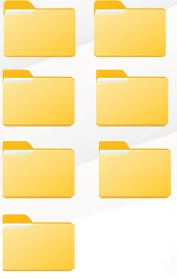
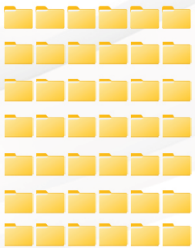
2. Digital folder structure on the computer
7-Folder System Overview
max. 7 main folders
max. 7 subfolders per main folder
= max. 49 folders in total
7 subfolders per
superordinate folder
= max. 343 folders in total
An optimal folder structure can be created by filing with the 7-folder system.
Source: Büro-Kaizen, Ideale Ordnerstruktur: Eine einheitliche Dateiablage mit dem 7-Ordner-System erstellen (für Unternehmen und Privatpersonen), in: buero-kaizen.de, https://www.buero-kaizen.de/ordnerstruktur/
30

Slide 31
2. Digital folder structure on the computer
The 7+2 concept
In addition to the 7 folders (the top level) we recommend 2 additional folders:
Folder 1
Archive
Folder
Documents that are no longer needed in the main folder are moved to the archive folder and regularly checked for deletion
Folder 2
Scan
Folder
If physical mail is received, we recommend photographing it with a mobile phone or scanning it.
Source: Schweizer Minimalist, Digitale Ordnerstruktur – Mein Ordnersystem auf dem PC, in: schweizer-minimalist.ch, 04.09.2021, https://schweizer-minimalist.ch/digitale-ordnerstruktur-mein-ordnersystem-auf-dem-pc/
31

Slide 32
2. Digital folder structure on the computer
Examples of a private folder structure according to the 7 concept
1.Occupation
Employment contracts
Assessments
Payroll
Curriculum vitae
Further education
Testimonials
2. Vehicles
Vehicle documents
Repairs
Accident documents
3. Finances and insurances
Attachments
Bank statements
Loans
Tax return
Insurance contracts
4. Health
Health insurance abroad
Documents
Vaccination certificate
Health insurance
5. Personal documents
Birth certificate
Confirmation of registration
Memberships (e.g. in a club or gym)
Passport
Will
6. Real estate
Rental agreements
Supply carrier
Broadcasting fees
7. Knowledge database
Article
Books
Collection of ideas
Magazines
Source: Büro-Kaizen, Ideale Ordnerstruktur: Eine einheitliche Dateiablage mit dem 7-Ordner-System erstellen (für Unternehmen und Privatpersonen), in: buero-kaizen.de, https://www.buero-kaizen.de/ordnerstruktur/
32

Slide 33
2. Digital folder structure on the computer
Advantages of a filing system with a uniform folder structure - in everyday working life
Shorter search times for documents and files
Better cooperation in the team
The productivity of the employees increases
Less double filing of documents
Enormous time saving
Easier representation of colleagues
Source: Büro-Kaizen, Ideale Ordnerstruktur: Eine einheitliche Dateiablage mit dem 7-Ordner-System erstellen (für Unternehmen und Privatpersonen), in: buero-kaizen.de, https://www.buero-kaizen.de/ordnerstruktur/
33

Slide 34
3. Store files locally in the computer or in the cloud
Cloud services allow people to store files online in such a way that they can access them from anywhere in the world over the network.
34

Slide 35
3. Store files locally in the computer or in the cloud
Advantages and disadvantages of data storage in the cloud versus on-site storage
Cloud storage
On-site storage
Reduced costs, as no own hardware has to be purchased
Adaptable to own business developments
Efficient data backup
Data can be used without an internet connection
Reduced internet costs, as less data transfer is required
Security and data protection are given
Only online access possible
The more service is demanded, the more the costs rise
More storage space means new investments in hardware
Increased risk of data loss
Recovering lost files can be costly and time-consuming
Source: Hagel, Jens. Vor-Ort vs. Cloud-Speicher: Was ist besser? Ein Vergleich, in: hagel-it.de, https://www.hagel-it.de/cloud/vor-ort-vs-cloud-speicher-was-ist-besser-ein-vergleich.html + Kristian (2019), Je 5 Vor- und Nachteile von Cloud Speichern, in: cloudzzer.com, 17. März 2018, https://www.cloudzzer.com/pro-und-contra-von-cloudspeicher
35

Slide 36
Unit 3
Retrieval from
Files - or:
How do I keep the
Overview of the saved files?
36

Slide 37
1. Problems of a deficient filing structure
Why do files disappear on the computer?
Files are accidentally deleted from the desktop on the computer
Files are moved to the desktop
There are synchronisation problems with the cloud
Folder structure too complex to find files again
Data loss due to power failure
There are virus infections on the computer
37

Slide 38
1. Problems of a deficient filing structure
Most companies have a folder structure for their digital filing. This folder structure is not always good.
From these problems you can see that your folder structure needs to be improved:
You or your colleagues have to search for files very often or for a very long time!
Content has to be recreated because files and thus knowledge can no longer be found!
Sometimes files get lost or cannot be found at all!
You have to click more than 3 times to get to your target file!
Substitutes or new employees find it difficult to find their way around the folder structure of the digital filing system. The familiarisation period therefore takes longer!
Too many subfolders make searching difficult or there are very many files stored in very few folders!
There are many files with unclear names or in several versions. It is not always immediately recognisable which is the latest version of a file!
Source: TechSmith, Eine digitale Ordnerstruktur fürs Unternehmen einrichten: Beispiel und Tipps, in: techsmith.de, https://www.techsmith.de/blog/digitale-ordnerstruktur/
38

Slide 39
1. Problems of a deficient filing structure
Importance of a good structure - basis for quick retrieval
These benefits apply to older employees in companies as well as to citizens of retirement age and to companies as a whole.
Important documents such as contracts do not disappear in the mass of folders and files.
You save time: The long or frequent search for individual files is over. You reduce the file search to a minimum of time and that means work relief.
The file names are unique and clearly indicate which files and information represent the latest status.
Server maintenance is simplified: as there is no multiple storage of files, you need less storage space, also for your backup copies and backups.
New employees and holiday replacements quickly find their way around the folder structure. The familiarisation period is shortened and onboarding is faster.
A clear filing system and folder structure can have a positive impact on job satisfaction, as you spend less time searching for files and more time on the actual work.
The quality of work can also increase with a suitable folder structure for digital filing: Files are less likely to be filed outside the structure, with unclear names or twice.
Source: TechSmith, Eine digitale Ordnerstruktur fürs Unternehmen einrichten: Beispiel und Tipps, in: techsmith.de, https://www.techsmith.de/blog/digitale-ordnerstruktur/
39

Slide 40
2. Tools for finding files in your own folder structure
Windows - Search files I
Search files via start menu
1
Open the Start menu.
2
Now type in the file name (or part of it).
3
Windows 10 now displays search results in different categories.
4
You can refine your search above:
You can use the icons to restrict (filter) your search to apps, documents or the web search, for example.
If you click on the lettering: "More" at the top, you can also search specifically for settings, photos, music, e-mail, folders, people and videos.
.
Source: Schanze, Robert (2016), Windows 10: Nach Dateien suchen – so geht's, in: giga.de, 18. Dez. 2016, https://www.giga.de/downloads/windows-10/tipps/windows-10-nach-dateien-suchen-so-gehts/
40

Slide 41
2. Tools for finding files in your own folder structure
Windows - Search files II
Search and find files in the folder faster
If you already know roughly in which parent folder the files you are looking for are located, you can also do the following:
1
Open the corresponding folder in Windows Explorer (shortcut: Windows + E).
2
Now press the key combination Ctrl + F to jump to the search field at the top right.
Alternatively, click with the mouse.
3
Type in the file you are looking for.
This can also be just the file extension or part of the file name.
4
You can also limit the search and use the asterisk (*) as a wildcard.
This sometimes makes the search considerably faster:
- For example, the search term *.doc only shows found files with the file extension DOC.
- letter*.xls displays all XLS files that start with the word letter in the file name.
Source: Schanze, Robert (2016), Windows 10: Nach Dateien suchen – so geht's, in: giga.de, 18. Dez. 2016, https://www.giga.de/downloads/windows-10/tipps/windows-10-nach-dateien-suchen-so-gehts/
41

Slide 42
2. Tools for finding files in your own folder structure
MAC - Search files
Search files with Spotlight
Launch Spotlight.
Press the COMMAND + SPACE keys to launch Spotlight on your Mac computer.
Enter the file name.
If you now remember the name, you can enter the file name of the actual file you are looking for.
This way you can find lost files on the Mac.
Check the results.
A list of results appears underneath.
Check the list and scroll through it.
Check the path directory.
The last thing to do is to hold down the COMMAND key to check the path of the directory of the folder or file.
You can also click on the specific file and then press the button for COMMAND.
1
2
3
4
Source: Baldo, Jordan, Der beste Weg, um verlorene Dateien auf dem Mac zu finden, in: imymac.de, 1. August 2022, https://www.imymac.de/powermymac/find-lost-files-on-mac.html
42

Slide 43
3. Tips for Digital Online Management
Develop your own structure and use it consistently
Title documents so that you can find them again
Refrain from saving documents only in the email inbox
Store data locally or in the cloud - make this decision consciously
Save all mails incl. attachments
Keep costs fixed and at a glance
Keep the documents up to date and check them regularly
Check the download folder regularly
Consistently save all documents
Archive old files in the archive
Remember deadlines for documents - if necessary
Back up the data regularly
43

Slide 44
Test your knowledge!
"Googling" is a synonym for:
Set the screen font to the format: Google
Internet search with the Google search engine
Accessibility on the computer according to Google specifications
Please answer the following questions:
When researching in search engines, special attention must be paid to:
Popularity with young users
The best animation of the content
Balance of information
What should I pay particular attention to when backing up data?
The 8-7-6 Rule
Storage in common formats such as PDF, JPG, WORD, EXCEL ...
Regular inspection of the storage media after 10 years at the earliest
A digital folder structure that is accepted and supported by all employees is characterised by:
The 7+2 Folder System
Double filing of all files
Determination of the structure by the supervisor(s)
Digital online management is necessary because:
This is the only way for new employees to get an overview quickly
The own IT department only knows where data is stored in this way
Saving data in the e-mail inbox helps to keep the amount of data in the organisational structure low.
44

Slide 45
Test your knowledge!
"Googling" is a synonym for:
Set the screen font to the format: Google
Internet search with the Google search engine
Accessibility on the computer according to Google specifications
Solution:
When researching in search engines, special attention must be paid to:
Popularity with young users
The best animation of the content
Balance of information
What should I pay particular attention to when backing up data?
The 8-7-6 Rule
Storage in common formats such as PDF, JPG, WORD, EXCEL ...
Regular inspection of the storage media after 10 years at the earliest
A digital folder structure that is accepted and supported by all employees is characterised by:
The 7+2 Folder System
Double filing of all files
Determination of the structure by the supervisor(s)
Digital online management is necessary because:
This is the only way for new employees to get an overview quickly
The own IT department only knows where data is stored in this way
Saving data in the e-mail inbox helps to keep the amount of data in the organisational structure low.
45

Slide 46
Summing up
Well done! Now you know more about:
Recognise the usefulness of the internet in finding the important data
The use of search engines for data search
The importance of a good digital folder structure as a basis for structured file storage
Advantages and disadvantages of storing locally or in the cloud
Retrieving files on the computer with the right tools
46

Slide 47
Bibliography
Initiative D21 e.V. (2018), D21 DIGITAL INDEX 2017/2018. Jährliches Lagebild zur Digitalen Gesellschaft, in: initiatived21.de, 2018, https://initiatived21.de/app/uploads/2018/01/d21-digital-index_2017_2018.pdf
Treppenlift-ratgeber.de, Internet für Senioren: Werden Sie zum Silver Surfer, in: treppenlift-ratgeber.de, https://www.treppenlift-ratgeber.de/barrierefrei-leben/leben-im-alter/internet-fuer-senioren.html
diabsite.de, Welchen besonderen Nutzen bietet das Netz für Senioren?, in: diabsite.de, 24.06.2007, https://www.diabsite.de/wegweiser/links/internet/5-senioren.html
BAFSO – Bundesarbeitsgemeinschaft der Seniorenorganisationen e.V. (2019), Wegweiser durch die digitale Welt - Für ältere Bürgerinnen und Bürger (10. aktualisierte Auflage), in: basgo.de, Dezember 2019, https://www.bagso.de/publikationen/ratgeber/wegweiser-durch-die-digitale-welt/
BAGSO Service Gesellschaft mbH, Anleitung 8: Gesundheitsinformationen im Netz – kompetent nutzen, in: digital-kompass.de, 2023, https://www.digital-kompass.de/materialien/anleitung-8-gesundheitsinformationen-im-netz-kompetent-nutzen
47

Slide 48
Bibliography
Google Deutschland Team (2021), 7 Tipps, mit denen ihr noch mehr aus der Google Suche rausholt, in: google.de, 04. Juni 2021, https://blog.google/intl/de-de/produkte/suchen-entdecken/7-tipps-fuer-die-google-suche/
IONOS (2022), Daten sichern: Methoden und Medien im Überblick, in: ionos.de, 13.09.2022, https://www.ionos.de/digitalguide/server/sicherheit/daten-sichern/
Verbund Forschungsdaten Bildung (VerbundFDB), Dateien benennen und organisieren, in: forschungsdaten-bildung.de, 20.07.2018, https://www.forschungsdaten-bildung.de/dateien-benennen
Büro-Kaizen, Ideale Ordnerstruktur: Eine einheitliche Dateiablage mit dem 7-Ordner-System erstellen (für Unternehmen und Privatpersonen), in: buero-kaizen.de, https://www.buero-kaizen.de/ordnerstruktur/
Miller’s Law, The average person can only keep 7 (plus or minus 2) items in their working memory, in: lawsofux.com, https://lawsofux.com/millers-law/
48

Slide 49
Bibliography
Schweizer Minimalist, Digitale Ordnerstruktur – Mein Ordnersystem auf dem PC, in: schweizer-minimalist.ch, 04.09.2021, https://schweizer-minimalist.ch/digitale-ordnerstruktur-mein-ordnersystem-auf-dem-pc/
Hagel, Jens. Vor-Ort vs. Cloud-Speicher: Was ist besser? Ein Vergleich, in: hagel-it.de, https://www.hagel-it.de/cloud/vor-ort-vs-cloud-speicher-was-ist-besser-ein-vergleich.html
Kristian (2019), Je 5 Vor- und Nachteile von Cloud Speichern, in: cloudzzer.com, 17. März 2018, https://www.cloudzzer.com/pro-und-contra-von-cloudspeicher
TechSmith, Eine digitale Ordnerstruktur fürs Unternehmen einrichten: Beispiel und Tipps, in: techsmith.de, https://www.techsmith.de/blog/digitale-ordnerstruktur/
Schanze, Robert (2016), Windows 10: Nach Dateien suchen – so geht's, in: giga.de, 18. Dez. 2016, https://www.giga.de/downloads/windows-10/tipps/windows-10-nach-dateien-suchen-so-gehts/
Baldo, Jordan, Der beste Weg, um verlorene Dateien auf dem Mac zu finden, in: imymac.de, 1. August 2022, https://www.imymac.de/powermymac/find-lost-files-on-mac.html
49

Slide 50
www.digital-boomer.eu
Thank you!
50

