Slide 1
www.digital-boomer.eu
Safe and Smart Online:
Managing Your Digital Identity and Interactions
Provided by: IDP & IHF

Slide 2
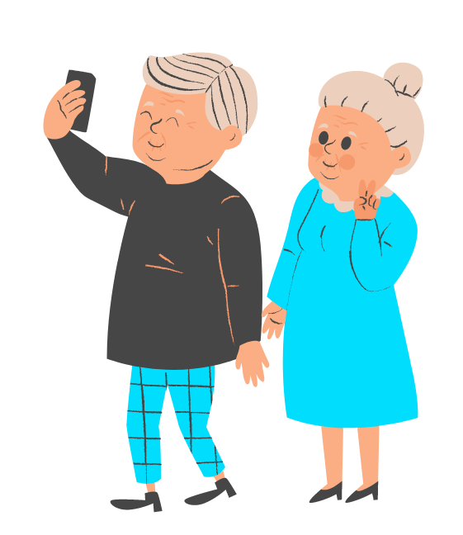
Introduction
As we navigate the digital world, it is crucial to understand how to create and manage our digital identity, and how to interact responsibly with others online.
This module encompasses the key themes of:
Managing digital identity
Following online behaviour guidelines
Throughout this module, you will acquire the knowledge and skills to:
Manage your online presence
Communicate responsibly
Collaborate effectively in the digital realm

Slide 3
Index
Creating and Securing Your Digital Identity
Digital Identity: Concepts and Elements
1
Establishment and Safeguard of Your Online Presence
Nuances of Effective Digital Communication
Practicing Responsible Online Behaviour
2
Proper Language, Tone and Netiquette in Online Interactions
Guidelines for Practicing Mindful and Responsible Online Engagement

Slide 4
Objectives
At the end of this module you will be able to:
Understand the concept of digital identity and its key elements
Recognise the importance of managing and protecting your digital identity
Establish and maintain a positive and authentic online presence
Understand the nuances and challenges of digital interactions
Apply strategies for clear, concise and responsable digital communication
Manage and avoid risks connected with not responsible online engagement

Slide 5
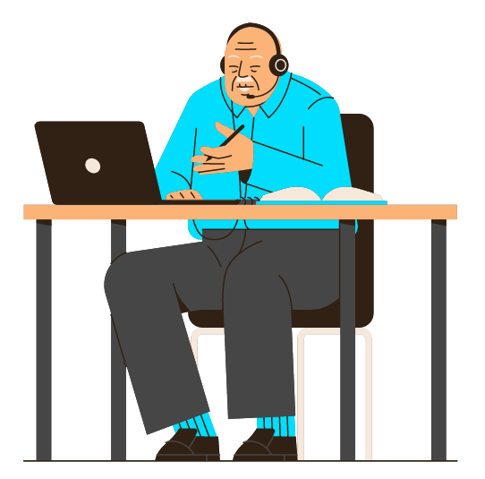
Unit 1
Creating and Securing Your Digital Identity

Slide 6
1. Creating and Securing Your Digital Identity
Digital Identity: Concepts and Elements
What is a Digital Identity?
A digital identity is commonly understood as a unique connection between an entity and its online presence.
one-to-one relationship
Your digital identity is established through your online presence and is developed through interactions and thus activities.
This concept goes beyond the mere user’s one as it delves deeper into the intricacies of individual’s digital presence.
While a user represents anyone actually engaging on digital platforms, the digital identity refers to the specific attributes, profiles and reputation associated with the aforementioned digital presence.

Slide 7
1. Creating and Securing Your Digital Identity
Digital Identity: Concepts and Elements
This one-to-one relationship between an entity and its online presence is a data-based relationship.
Indeed, digital identity encompasses data and information utilised by computer systems to refer to external entities, such as persons, organisations, applications, devices.
FOCUS ON INDIVIDUALS
Individuals establish their digital identity through the compilation of various data points, resulting in personally identifiable information (PII). These latter include personal details, credentials, and entitlements associated with individuals' online presence and activities.
By comprehending the underlying principles and elements of digital identity, individuals can make informed decisions about their digital interactions and take necessary measures to protect their privacy and security online.

Slide 8
1. Creating and Securing Your Digital Identity
Digital Identity: Concepts and Elements
Let’s discover the elements that contribute to your digital identity.
Personal Information
Name
Age
Addresses and numbers (physical and not)
Biometric data

Slide 9
1. Creating and Securing Your Digital Identity
Digital Identity: Concepts and Elements
Let’s discover the elements that contribute to your digital identity.
Personal Information
Name
Age
Addresses and numbers (physical and not)
Biometric data
Credentials
Usernames
Passwords
Authentication mechanisms
Security questions

Slide 10
1. Creating and Securing Your Digital Identity
Digital Identity: Concepts and Elements
Let’s discover the elements that contribute to your digital identity.
Personal Information
Name
Age
Addresses and numbers (physical and not)
Biometric data
Credentials
Usernames
Passwords
Authentication mechanisms
Security questions
Online Profiles
Social media (Facebook, Instagram, Twitter, etc.)
Professional networking (LinkedIn, etc.)
Online forums and communities
Blog or website

Slide 11
1. Creating and Securing Your Digital Identity
Digital Identity: Concepts and Elements
Let’s discover the elements that contribute to your digital identity.
Personal Information
Name
Age
Addresses and numbers (physical and not)
Biometric data
Credentials
Usernames
Passwords
Authentication mechanisms
Security questions
Online Profiles
Social media (Facebook, Instagram, Twitter, etc.)
Professional networking (LinkedIn, etc.)
Online forums and communities
Blog or website
Digital Footprint
Search history
Website visit logs
Online purchases and transactions
Social media posts, reactions and comments

Slide 12
1. Creating and Securing Your Digital Identity
Digital Identity: Concepts and Elements
Let’s discover the elements that contribute to your digital identity.
Personal Information
Name
Age
Addresses and numbers (physical and not)
Biometric data
Credentials
Usernames
Passwords
Authentication mechanisms
Security questions
Online Profiles
Social media (Facebook, Instagram, Twitter, etc.)
Professional networking (LinkedIn, etc.)
Online forums and communities
Blog or website
Digital Footprint
Search history
Website visit logs
Online purchases and transactions
Social media posts, reactions and comments
Privacy Settings
Privacy controls on social media
Who can see your posts and profile information
Data collection by third-party apps and websites
Opting out of targeted advertising

Slide 13
1. Creating and Securing Your Digital Identity
Digital Identity: Concepts and Elements
Let’s discover the elements that contribute to your digital identity.
Personal Information
Name
Age
Addresses and numbers (physical and not)
Biometric data
Credentials
Usernames
Passwords
Authentication mechanisms
Security questions
Online Profiles
Social media (Facebook, Instagram, Twitter, etc.)
Professional networking (LinkedIn, etc.)
Online forums and communities
Blog or website
Digital Footprint
Search history
Website visit logs
Online purchases and transactions
Social media posts, reactions and comments
Privacy Settings
Privacy controls on social media
Who can see your posts and profile information
Data collection by third-party apps and websites
Opting out of targeted advertising
Online Reputation
Feedback and reviews
Endorsements and recommendations on network’s sites
Reactions and comments on own posts
Online presence in news article or blogs

Slide 14
1. Creating and Securing Your Digital Identity
Digital Identity: Concepts and Elements
Let’s discover the elements that contribute to your digital identity.
Personal Information
Name
Age
Addresses and numbers (physical and not)
Biometric data
Credentials
Usernames
Passwords
Authentication mechanisms
Security questions
Online Profiles
Social media (Facebook, Instagram, Twitter, etc.)
Professional networking (LinkedIn, etc.)
Online forums and communities
Blog or website
Digital Footprint
Search history
Website visit logs
Online purchases and transactions
Social media posts, reactions and comments
Privacy Settings
Privacy controls on social media
Who can see your posts and profile information
Data collection by third-party apps and websites
Opting out of targeted advertising
Online Reputation
Feedback and reviews
Endorsements and recommendations on network’s sites
Reactions and comments on own posts
Online presence in news article or blogs

Slide 15
1. Creating and Securing Your Digital Identity
Digital Identity: Concepts and Elements
These elements are summarised in what a person…
…is
…knows
…has
…does
Personal Information
Credentials
Privacy Settings
Online Profiles
Digital Footprint
Online Reputation

Slide 16
1. Creating and Securing Your Digital Identity
Establishment and Safeguard of Your Online Presence
Building your online presence allows interaction with others, sharing of interest, and engagement in the digital world.
According to the World Bank (ID4D Practitioner’s Guide, 2019), the basic structure of the digital identity and identification process is based on:
Who are you?
Are you who claim to be?
Are you authorised or eligible?
Identification
Authentication
Authorisation
Verifying and consolidating pertinent identity information to establish an individual’s digital presence
Assessing the authenticity of and individual’s claimed identity through the examination of one or multiple personal details (or PII)
Validating specific attributes to determine the authorisation or eligibility of an individual to participate

Slide 17
1. Creating and Securing Your Digital Identity
Establishment and Safeguard of Your Online Presence
By virtue of the elements – what a person is, knows, has and does – and the structure of the digital identity and identification, here are some advice (A), tips (T) and methods (M) for each key concept in building your online presence.
Personal Information
A: Only share necessary personal information online, such as your name, email address, and professional details
T: Avoid sharing your home address, phone number, or other sensitive information unless necessary. Consider using pseudonyms or initials instead of full names where appropriate
M: Use discretion when filling out online forms, social media profiles, and registration pages. Provide information on a need-to-know basis

Slide 18
1. Creating and Securing Your Digital Identity
Establishment and Safeguard of Your Online Presence
Credentials
A: Create strong passwords that are difficult for others to guess
T: Use a combination of letters (uppercase and lowercase), numbers, and special characters in your passwords. Avoid using common words, sequential numbers or personal references. Consider using passphrases
M: Utilise password management tools, such as LastPass or KeePass, to generate and store complex passwords securely. Enable two-factor authentication (2FA) wherever possible for an additional layer of security
Online Profiles
A: Tailor your online profiles to reflect your professional image and goals
T: Highlight your skills, experiences, and achievements relevant to your desired online presence. Use keywords and industry-specific terminology to enhance visibility
M: Regularly update your profiles to stay current and engage with relevant online communities

Slide 19
1. Creating and Securing Your Digital Identity
Establishment and Safeguard of Your Online Presence
Digital Footprint
A: Be mindful of the content you share online and its potential impact
T: Think twice before posting anything. Consider the potential long-term consequences of your online activities
M: Regularly search for your name and review your digital footprint. Set up alerts to receive and check notifications when people interact with you and your digital identity
Privacy Settings
A: Understand and utilise the privacy settings available on different platforms
T: Review and customise privacy settings to match your desired level of online visibility and data collection. Limit access to personal information to trusted connections and on a need basis
M: Familiarise yourself with the privacy settings of social media platforms, email services, websites, apps, and other online accounts. Regularly check and adjust your privacy preferences as needed

Slide 20
1. Creating and Securing Your Digital Identity
Establishment and Safeguard of Your Online Presence
Online Reputation
A: Cultivate a positive online reputation through your online interactions and activities
T: Be respectful and professional in your online communications. Engage in constructive discussions and avoid engaging in negative or controversial behaviour
M: Participate in forums, contribute valuable content, and maintain a consistent and professional tone in your online interactions. Regularly monitor your online presence by searching for your name and be proactive in removing or requesting the removal of any unwanted or damaging content associated with your name

Slide 21
Unit 2
Practicing Responsible Online Behaviour

Slide 22
2. Practicing Responsible Online Behaviour
Nuances of Effective Digital Communication
Clear and Concise Communication is essential in the digital world as people have limited attention spans and receive numerous messages daily. → Get straight to the point and avoid lengthy explanations.
Example: Prefer “Could you please send me the report by EOD?” to “I wanted to ask if you could provide me with the report by the end of the day”. Note: EOD stands for “end of the day”.
Although this rule is generally valid, keep in mind that different models of digital communication require different approaches. For instance, e-mail is typically used for formal or detailed conversations, while instant messaging (WhatsApp, Messenger, Telegram, etc.) is more suitable for quick exchanges.
Example: If you need to discuss a complex project with multiple stakeholders, sending an e-mail with a detailed breakdown of tasks and deadlines would be appropriate.
Consequently, response times also differ, ranging from a few minutes to a maximum of 24 hours for messages on WhatsApp, up to the generally accepted 72 hours (3 days) waiting time for an e-mail.

Slide 23
2. Practicing Responsible Online Behaviour
Nuances of Effective Digital Communication
Non-verbal cues help convey emotions and intentions. Emoticons, emojis, and punctuation marks can add context and clarify the tone of your message.
They are also a way of expressing oneself in an essential, clear and concise manner, as introduced earlier.
Example: Thumbs-up emoji can indicate a confident and positive tone of approval.
👍
In addition to symbolism, also the effective use of formatting improves the readability of your messages. Use headings, bold or italicised text, bullet points, and numbered lists to better organise information and make it easier to understand.
Example: When sending an e-mail summarising key points from a meeting, use bullet points as follows.
Meeting’s key takeaways:
Report to be delivered by December 15, 2023
Dissemination to be improved with Press Releases’ publication
Next online call: January 9, 2024

Slide 24
2. Practicing Responsible Online Behaviour
Proper Language, Tone and Netiquette in Online Interactions
Using appropriate language and tone is crucial to convey your message accurately, avoiding misunderstanding.
Be mindful of the words you choose and the tone you adopt to maintain positive and effective interactions. And be aware that online (writing) communication generally lacks of facial expressions and tone of voice. Therefore, proper language and tone have an increased impact on how your message is received.
In a global online community, it’s important to be sensitive regarding social and cultural differences, by utilising a respectful and inclusive language.
Examples:
Prefer “I see your point, but I have a different perspective” to “You are wrong”, thus avoiding misunderstanding
Avoid using gender-specific terms or assumptions about someone’s background or identity – especially for religion or ethnicity.

Slide 25
2. Practicing Responsible Online Behaviour
Proper Language, Tone and Netiquette in Online Interactions
Although for the proper language and tone there are no obvious differences between online and offline communication, let’s introduce the netiquette (online etiquette) as a set of rules that promote appropriate and responsible behaviour in online interactions.
These rules play a vital role in:
Enhancing communication skills
Preventing misunderstanding
Providing guidelines on socially conduct when interacting and collaborating in a digital environment
Let’s focus on these rules and guidelines, including DO’s and DON’Ts.

Slide 26
2. Practicing Responsible Online Behaviour
Proper Language, Tone and Netiquette in Online Interactions
DO’s | DON’Ts
Choose proper grammar and punctuation | Don’t type in ALL CAPS (overuse)
Use appropriate formatting (bold, italic, paragraph, …) | Don’t attack or don’t use aggressive language
Integrate appropriate emojis and emoticons | Never send spam
Always include a subject line | Don’t overuse abbreviations
Reply messages promptly | Don’t share everywhere and to everyone (use discretion)
K.I.S.S.: Keep it short & sweet | “Don’t do to others what you wouldn’t want done to you”
Fact check before (re)posting
Be cautions with sarcasm
Respect the opinions, privacy and rights of others

Slide 27
2. Practicing Responsible Online Behaviour
Guidelines for Practicing Mindful and Responsible Online Engagement
As engagement in digital platforms and social media starts and increases, it is important to be aware of potential risks, particularly for those new to the digital world or working on improving digital literacy skills.
Let’s explore the strategies for effectively managing these risks and provides guidelines for practicing mindful and responsible online engagement.
Key areas of concern that will be addressed include:
Overuse and Alienation
Acting based on FOMO
Sharing of Fake News

Slide 28
2. Practicing Responsible Online Behaviour
Guidelines for Practicing Mindful and Responsible Online Engagement
Overuse and Alienation – To avoid excessive use in terms of time, leading to alienation and a disruption of the balance between online and offline interaction, the following guidelines are provided to maintain a healthy and productive harmony:
Time limits
Social connections
Mindful digital breaks
Set a daily maximum limit for online activities
Use calendar apps, reminders, or browser / app extensions to schedule specific time slots
Monitor your progress and adjust accordingly
Example: Use Instagram’s time limit built-in tool with alerts
Avoid relying solely on online communication
Foster deeper connections and prevent isolation
Example: Schedule regular face-to-face meetups with friends and family
Incorporate regular offline activities into your routine
Engage in hobbies, exercise, or spend time in nature
Refresh your mind and enhance well-being

Slide 29
2. Practicing Responsible Online Behaviour
Guidelines for Practicing Mindful and Responsible Online Engagement
Acting based on FOMO – FOMO, which stands for Fear of Missing Out, refers to the fear of not experiencing or participating in all available opportunities and the associated joy that comes with them. It is characterised by a curated and idealised perception of other people’s lives, which can lead to feelings of inadequacy or anxiety.
FOMO’s key aspects include:
Constant access to social media platforms
Continuous scrolling through feeds to stay updated
Constantly comparing oneself to others and losing touch with one’s own identity
Set realistic expectations
Engage in offline activities
To mitigate the effects of acting based on FOMO,
consider the following guidelines:
Utilise features (mute / unfollow) to reduce exposure
Practice digital detox:
Tech-free hours or days

Slide 30
2. Practicing Responsible Online Behaviour
Guidelines for Practicing Mindful and Responsible Online Engagement
Sharing of Fake News – It leads to both an overall increase in misinformation (where FOMO has its greatest impact) and personal reputation damage (online reputation as a part of digital identity).
It is important to verify information before sharing it online → fact-checking.
Fact-checking involves evaluating the source by considering its credibility and checking if similar information is reported by reputable news outlets. Here are two practical tools for fact-checking:
Google Fact Check Tools
BUFALE.net – Italy
It allows you to explore fake news by performing a keyword search. It has a section called 'recent fact checks' where you can find the most recent news already verified as fake.
A fact-checking website that focuses on debunking and exposing false information and hoaxes circulating online.

Slide 31
Test your knowledge!
Question 1. Which of the following is true about digital identity?
a: Digital identity cannot be managed or protected
b: Digital identity is not important in today’s digital age
c: Digital identity refers to the online presence and information associated with an individual
d: Digital identity has no impact on personal privacy
Please answer the following questions:
Question 2. What is the purpose of managing and protecting your digital identity?
a: To share personal information with anyone online
b: To engage in irresponsible online behaviour
c: To ignore the risks associated with online engagement
d: To establish and maintain a positive and authentic online presence
Question 3. Why is clear and concise communication important in the digital world?
a. Lengthy explanations are preferred for better understanding
b. Complex language enhances communication effectiveness
c. People have limited attention spans and receive numerous messages
d. Non-verbal cues compensate for unclear messages
What is FOMO in the context of social media?
a: Fear of Missing Out
b: Fear of Missing Others
c: Fear of Maximising Opportunities
d: Fear of Making Online Connections
Question 5. What is the purpose of fact-checking in online communication?
a. To spread rumours
b. To verify the accuracy of information before sharing
c. To engage in online debates and arguments
d. To share news based on personal opinions

Slide 32
Test your knowledge!
Question 1. Which of the following is true about digital identity?
a: Digital identity cannot be managed or protected
b: Digital identity is not important in today’s digital age
c: Digital identity refers to the online presence and information associated with an individual
d: Digital identity has no impact on personal privacy
Solutions:
Question 2. What is the purpose of managing and protecting your digital identity?
a: To share personal information with anyone online
b: To engage in irresponsible online behaviour
c: To ignore the risks associated with online engagement
d: To establish and maintain a positive and authentic online presence
Question 3. Why is clear and concise communication important in the digital world?
a. Lengthy explanations are preferred for better understanding
b. Complex language enhances communication effectiveness
c. People have limited attention spans and receive numerous messages
d. Non-verbal cues compensate for unclear messages
What is FOMO in the context of social media?
a: Fear of Missing Out
b: Fear of Missing Others
c: Fear of Maximising Opportunities
d: Fear of Making Online Connections
Question 5. What is the purpose of fact-checking in online communication?
a. To spread rumours
b. To verify the accuracy of information before sharing
c. To engage in online debates and arguments
d. To share news based on personal opinions

Slide 33
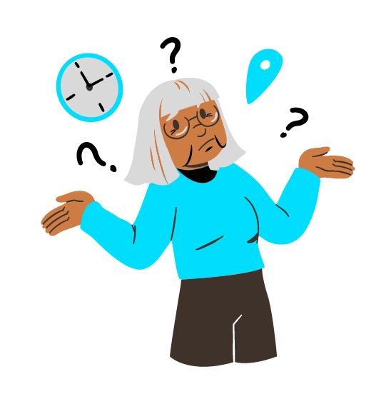
Summing up
Well done! Now you know more about:
Digital Identity Management: You have gained knowledge about the concept and elements of digital identity and how manage and safeguard it. You have explored the importance of personal information, credentials, online profiles, digital footprint, privacy settings and online reputation
Responsible Online Behaviour: You have learned about practicing responsible online behaviour, following the rules established by netiquette. You have also taken note of the guidelines to avoid risks such as overuse and alienation, acting on FOMO, sharing Fake News
Digital Literacy and Communication: You have developed digital literacy skills, enabling you to effectively navigate digital technologies, critically evaluate digital content, and communicate and collaborate online

Slide 34
www.digital-boomer.eu
Thank you!

